Slide 1
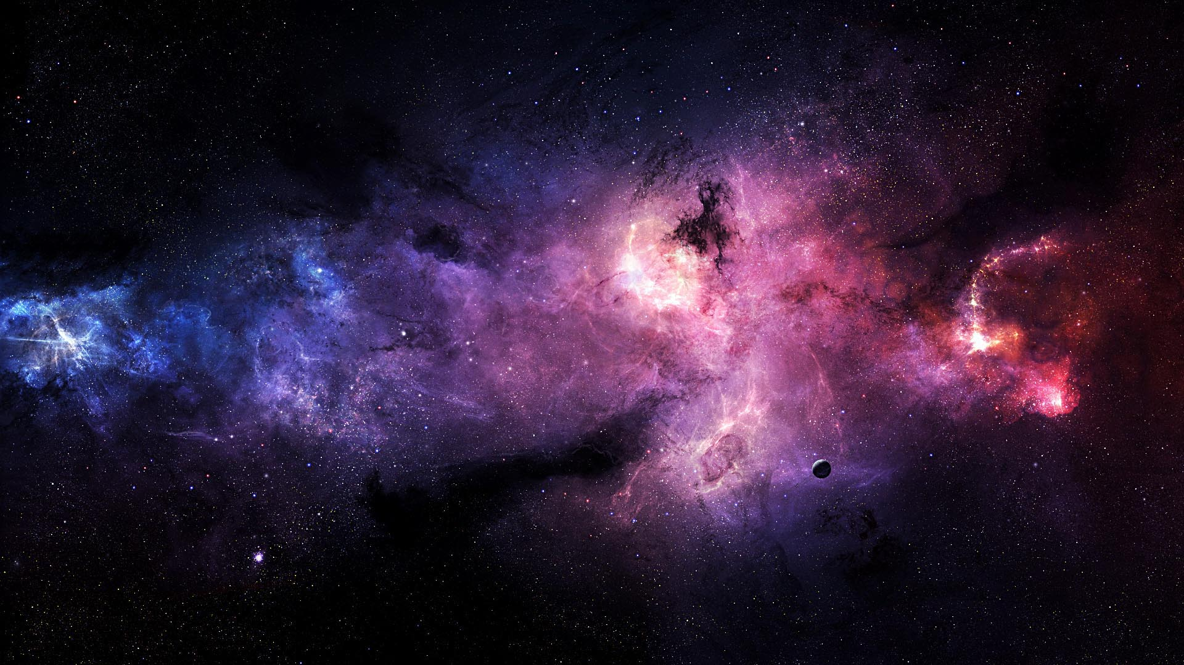
Visualizing 1 billion stars

Slide 2
team

Slide 3
Benjamin Neckam
Nicole Cherches
Alexander Gelb
Axinya Tokareva

Slide 4
agenda

Slide 5
1 Introduction
2 Lo-Fi Prototype
3 Hi-Fi Prototype
4 Conclusion

Slide 6
Introduction

Slide 7
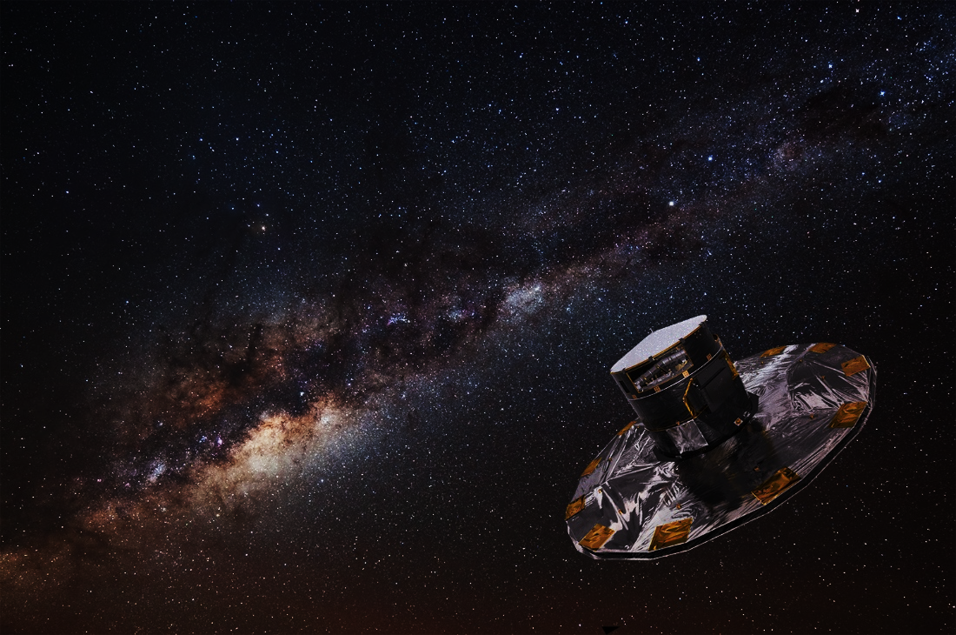
Topic Description
M1
ESA Mission
Gaia
First contact with data
million stars

Slide 8

Dataset
M1
positions
characteristics
distances
parallaxes
values of motions
magnitudes

Slide 9
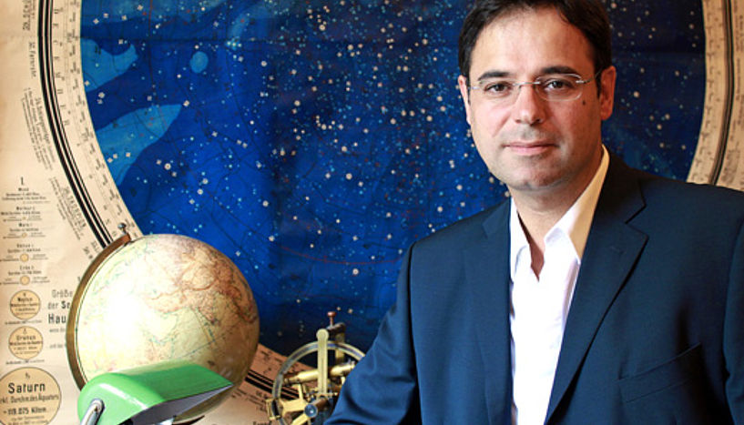
Fictitious User
M1
João Alves

Slide 10
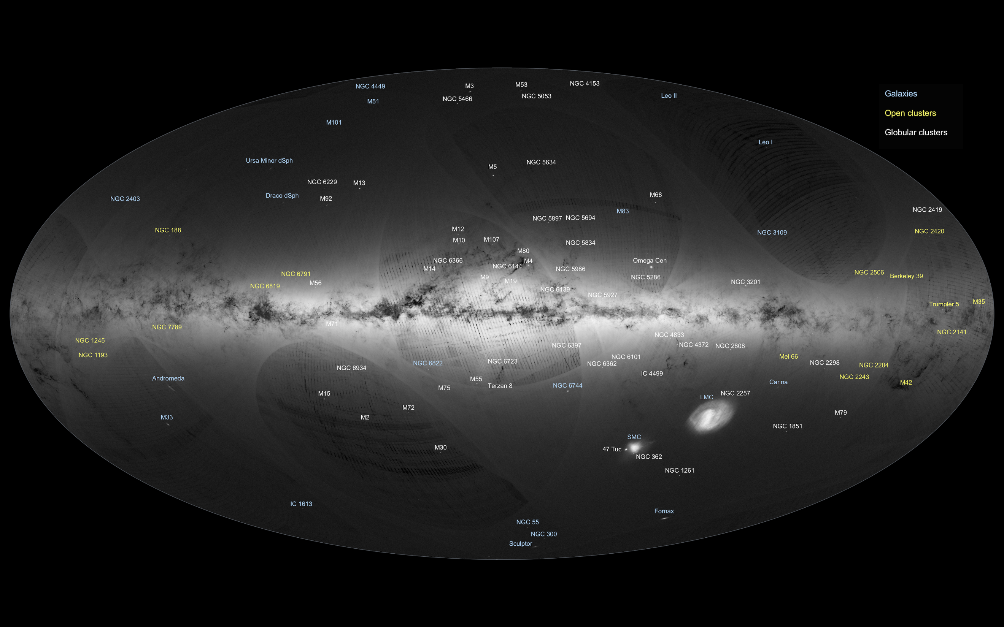
Gaia's first sky map [2]

Slide 11
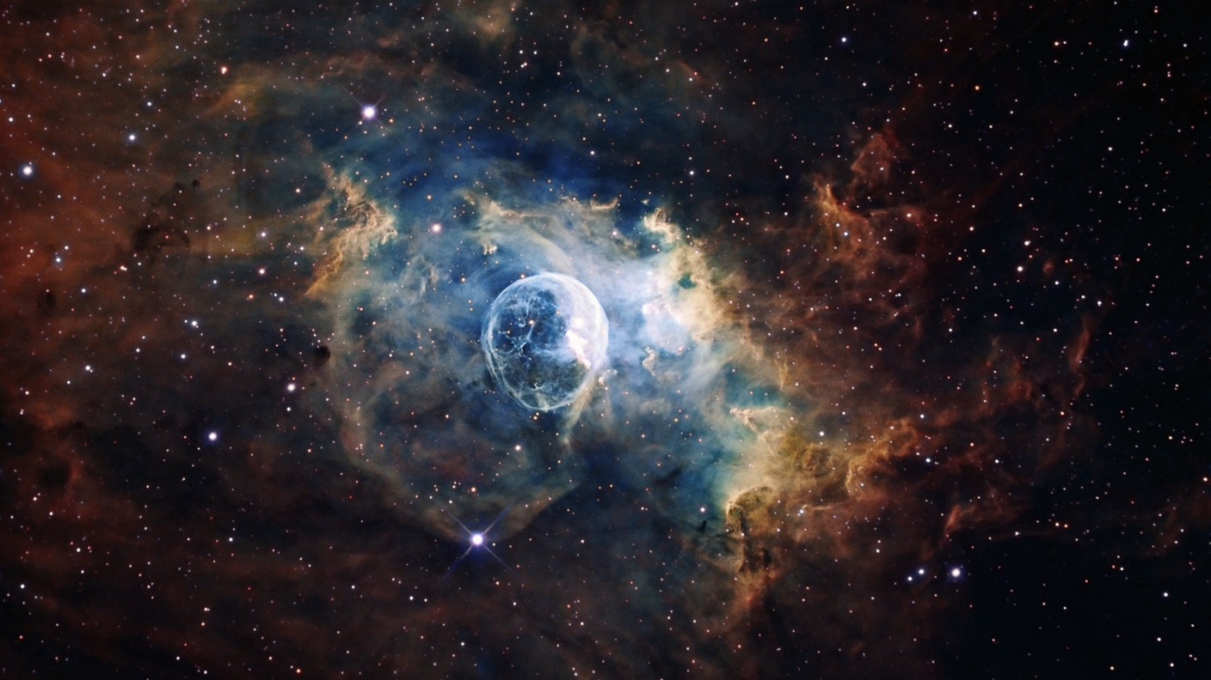
Lo-Fi Prototype
M2

Slide 12
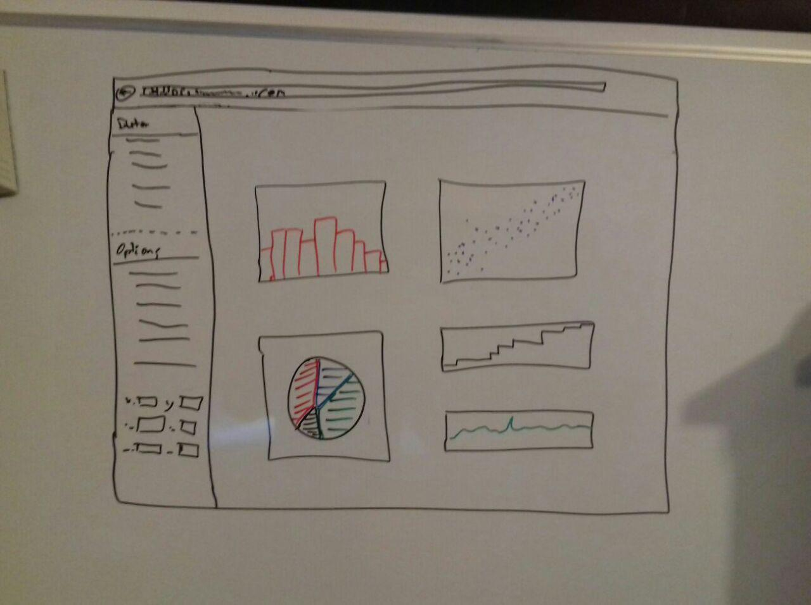
M2

Slide 13
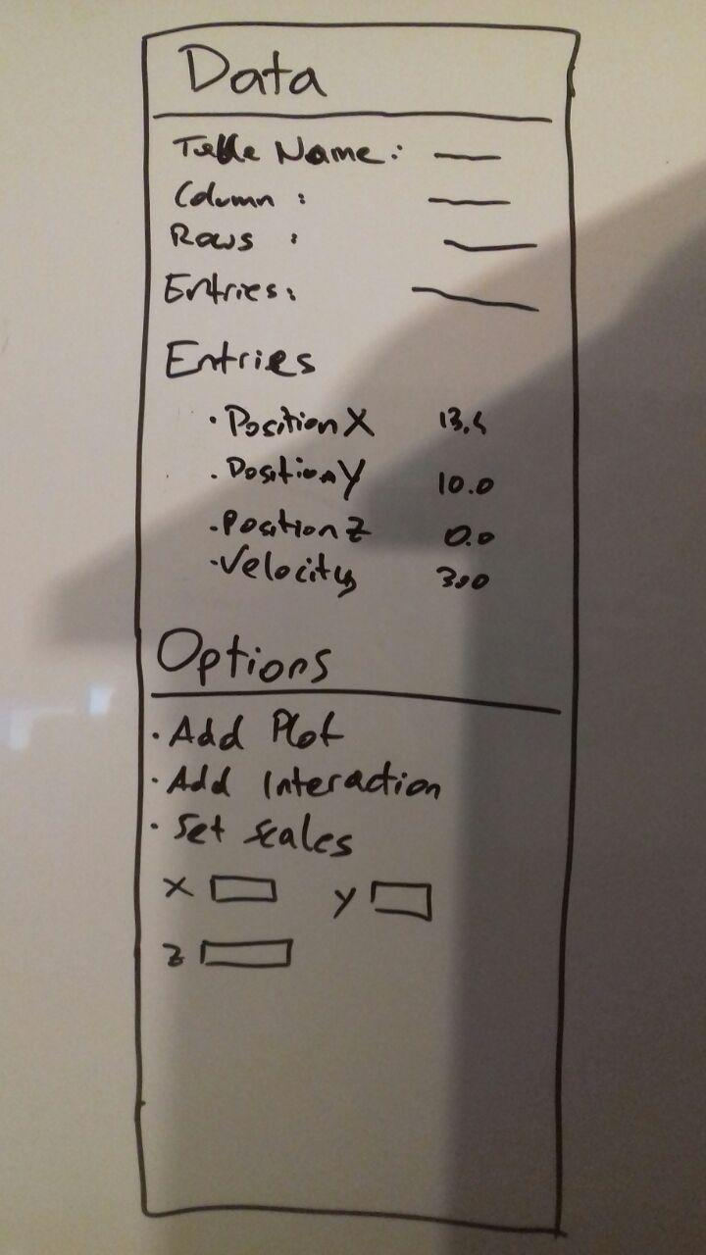
M2

Slide 14
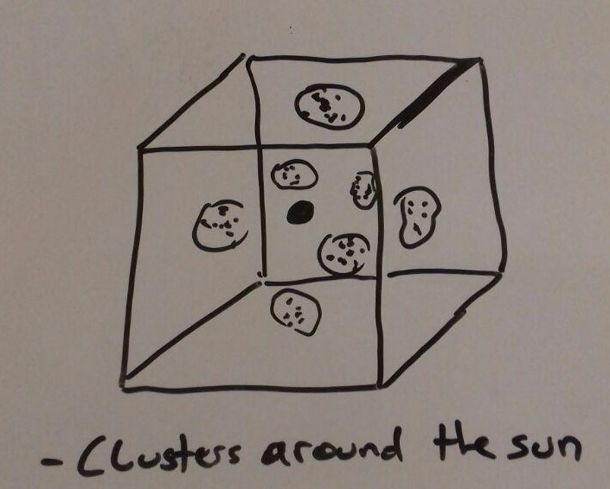
M2

Slide 15
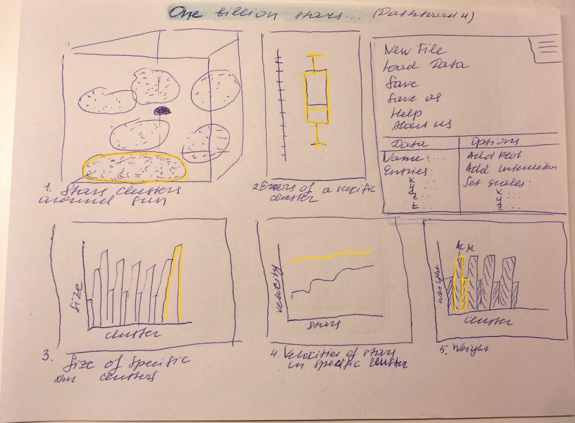
M2

Slide 16
TASKS
2 discovery of new objects
1 appearance and development
of our Galaxy with the help of
a survey of stars
3 detailed map
M2/3
5 Overview of the data
4 existence of black holes

Slide 17
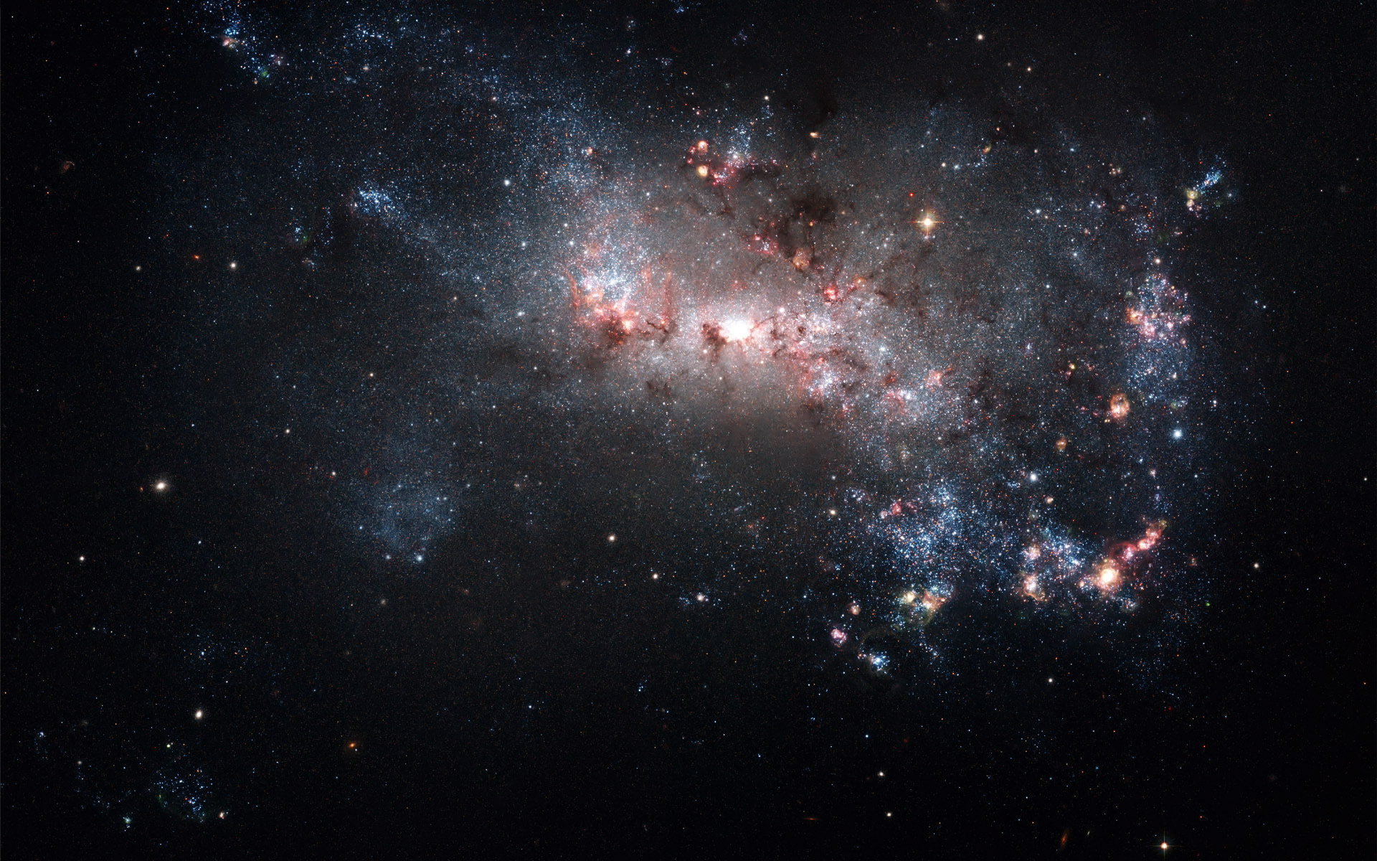
Hi-Fi Prototype
M3

Slide 18
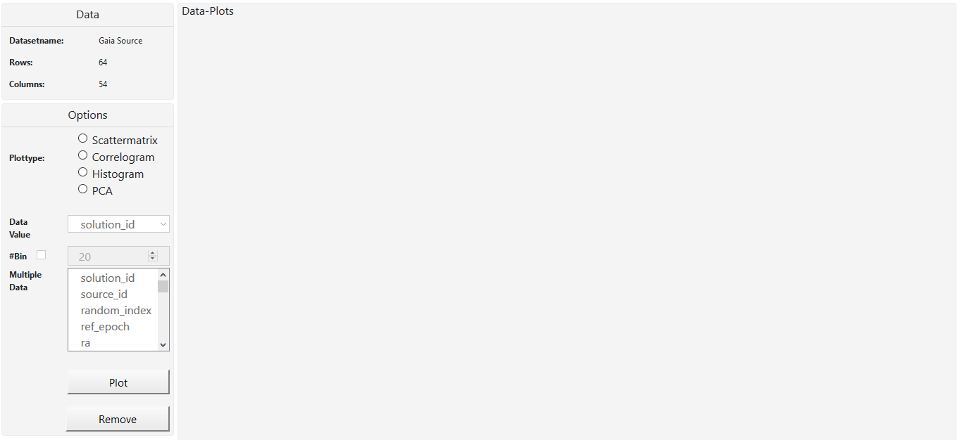
M3

Slide 19
//TODO scattermatrix image1
M3

Slide 20
//TODO scattermatrix image2
M3

Slide 21
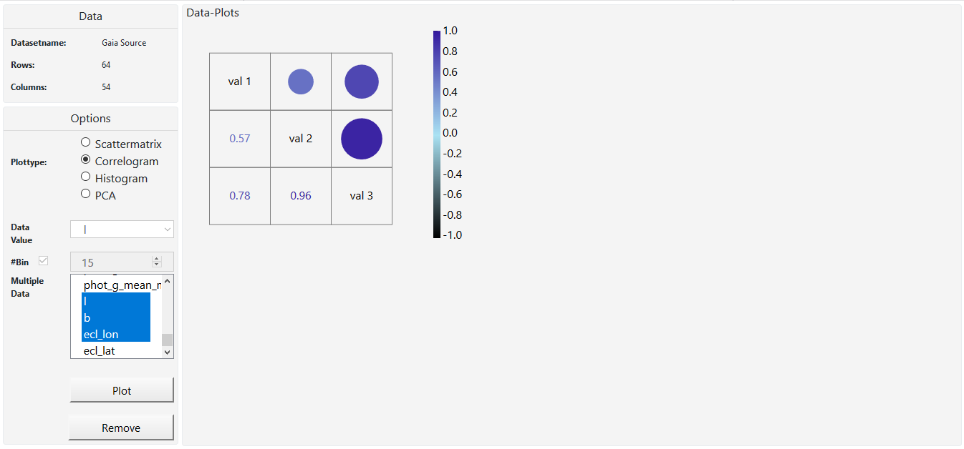
M3

Slide 22
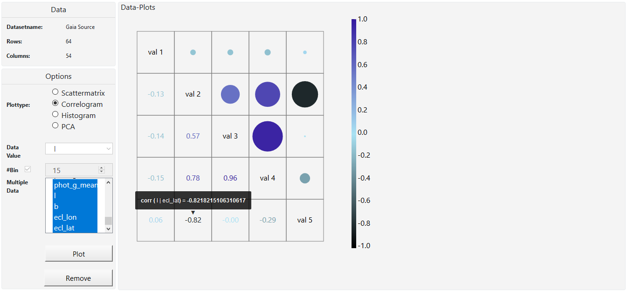
M3

Slide 23
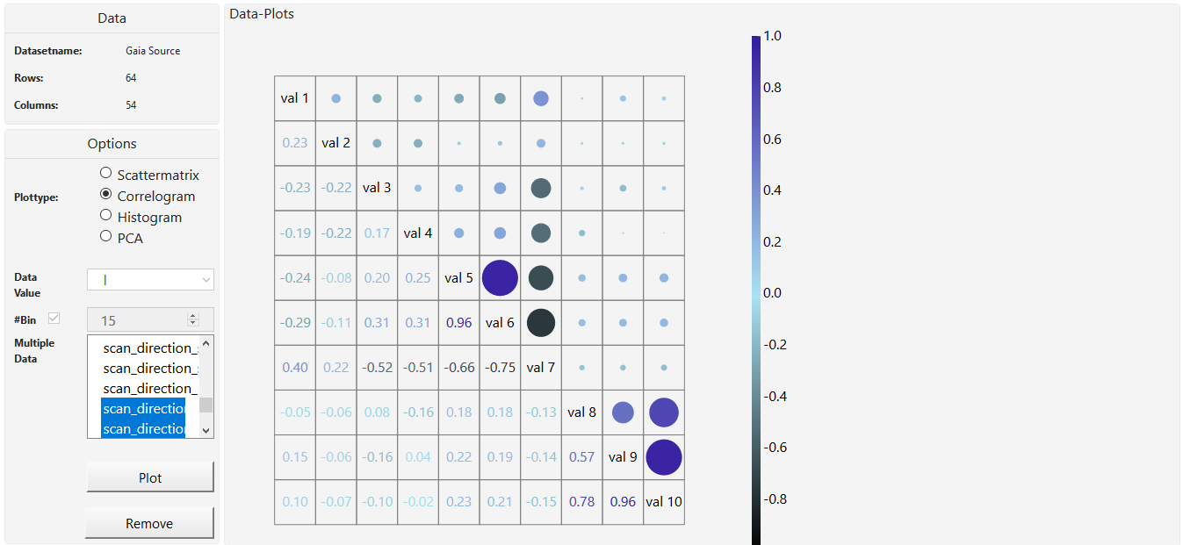
M3

Slide 24
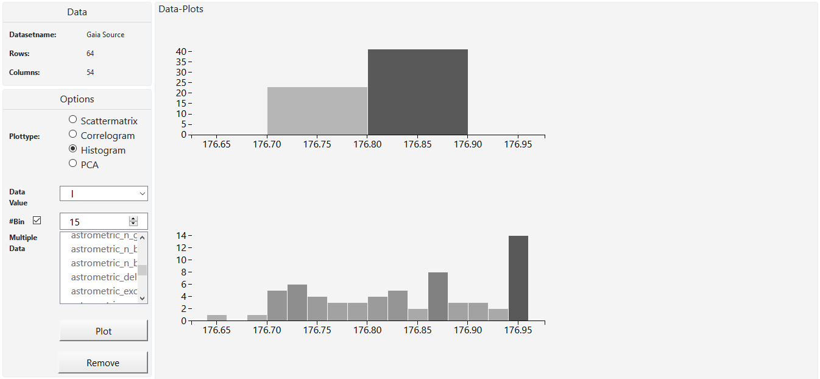
M3

Slide 25
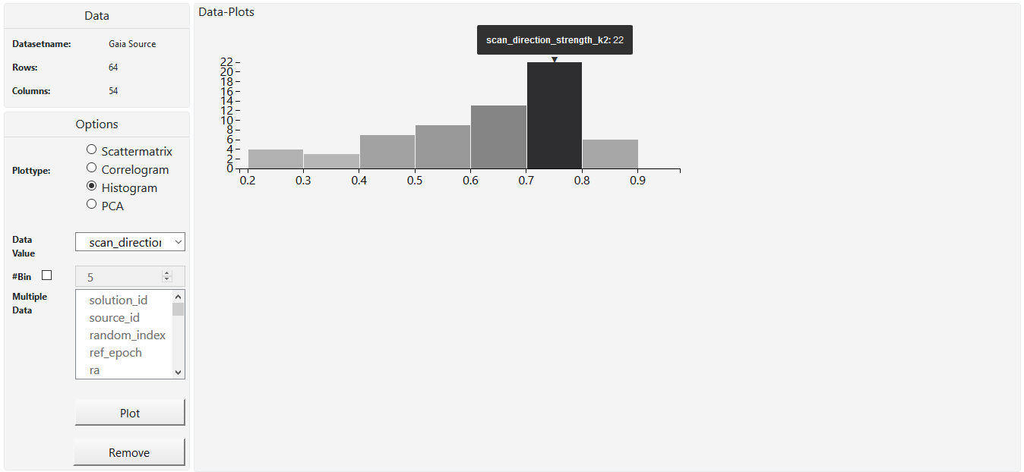
M3

Slide 26
//TODO pca image1
M3

Slide 27
//TODO pca image2
M3

Slide 28
Techniques
M3
1 tooltips
2 correlation over
multiple var
3 filter
4 brushing & linking

Slide 29
literatur

Slide 30
1 http://wwwlab.cs.univie.ac.at/~a1368965/vis17/
2 http://sci.esa.int/gaia/58275-data-release-1
3 Google images

Slide 31
vielen dank

Slide 32
fragen?

